Slide 1
Project Description:
This project involves analyzing job and user engagement data across multiple tables to derive key metrics and insights.
The purpose is to understand job review patterns, throughput, language distribution, user growth, retention, and engagement.
The analysis will provide actionable insights for optimizing operations, improving user retention, and enhancing product features.

Slide 2
Approach
Step 1: Data Understanding: The first step was to understand the structure and content of the provided datasets (job_data, users, events, and email_events). This included examining the fields and identifying any relevant relationships between the datasets.
Step 2: SQL Query Development: SQL queries were crafted to address specific tasks outlined in the case studies, such as calculating job review counts over time, throughput analysis, language share, detecting duplicate records, and analyzing user engagement, growth, and retention.
Step 3: Execution and Analysis: The queries were executed to generate the necessary data outputs. These outputs were then analyzed to extract meaningful insights.
Insight Synthesis: The results of the analysis were synthesized into key insights, which were summarized to support decision-making.

Slide 3
Tech-Stack
MySQL: MySQL was the primary database management system used for executing the SQL queries. It was used to store and manipulate the data for analysis.
MySQL Workbench: This tool was used as the interface for writing, testing, and executing SQL queries. Its visual and management features facilitated the exploration of data and validation of results.
Reasoning: User-Friendly Interface: - MySQL Workbench provides an intuitive GUI for database management, making it easier to visualize and manage the database structure.
Powerful Query Execution: It allows for efficient query execution and result analysis, which is crucial for performing the required tasks in this project.

Slide 4
Insights
Key Findings:
Jobs Reviewed Over Time: The analysis showed varying levels of job reviews per hour throughout November 2020, with specific peak hours that might align with organizational working hours or user behavior patterns.
Throughput Analysis: The 7-day rolling average provided a smoother trend line for throughput, making it easier to identify long-term patterns and anomalies compared to daily metrics, which can be volatile.
Language Share: The last 30 days showed the distribution of language usage, identifying the dominant languages and those that might require additional focus or resources.
Duplicate Rows: Identified duplicate records can indicate data quality issues, which should be addressed to maintain data integrity.
User Engagement: The weekly user engagement analysis highlighted active periods and allowed the identification of trends over time, which is crucial for understanding how users interact with the product.
User Growth: The analysis of user growth over time provided insights into periods of accelerated growth and potentially successful marketing campaigns or product launches.
User Retention: Weekly retention analysis revealed how well the product retains users over time, providing vital information for improving user experience and reducing churn.
Email Engagement: Email engagement metrics showed how users interact with email communications, which can be used to optimize email strategies and improve user outreach

Slide 5
Result
The project successfully identified key patterns and trends in job reviews, user engagement, and language distribution, among other metrics.
These insights are valuable for making informed decisions regarding product development, marketing strategies, and operational improvements.
The analysis has deepened the understanding of how users interact with the platform and how different factors influence these interactions, contributing to more effective decision-making and strategic planning.

Slide 6
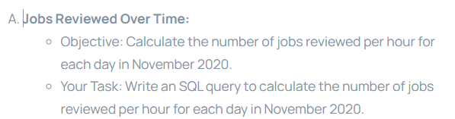
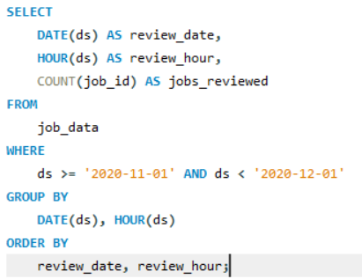
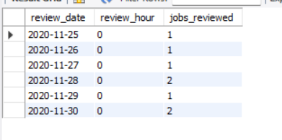

Slide 7
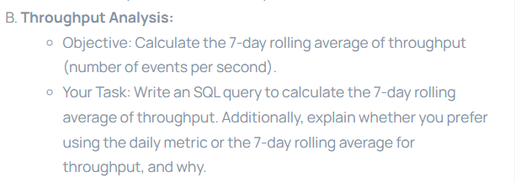
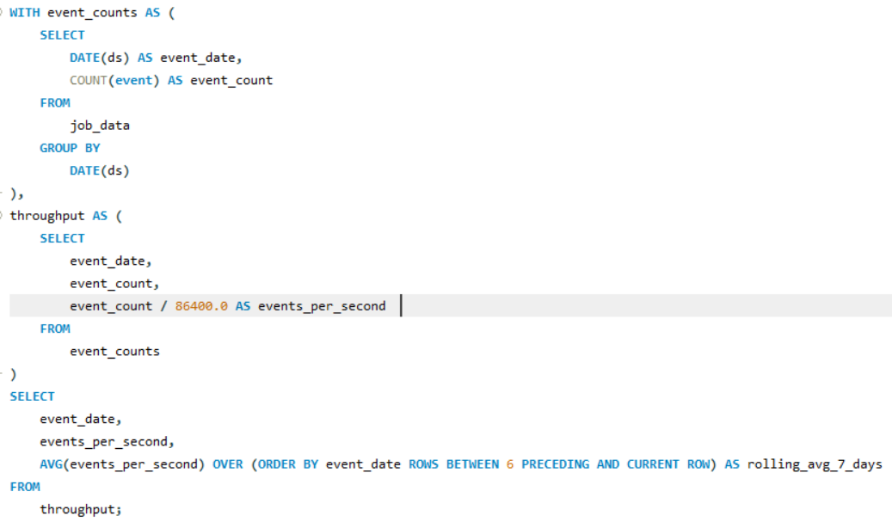
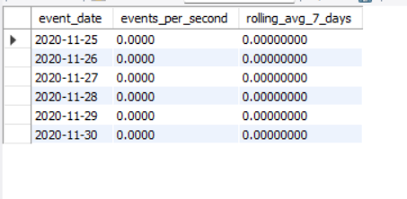

Slide 8
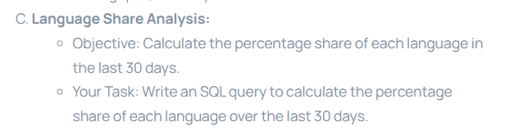
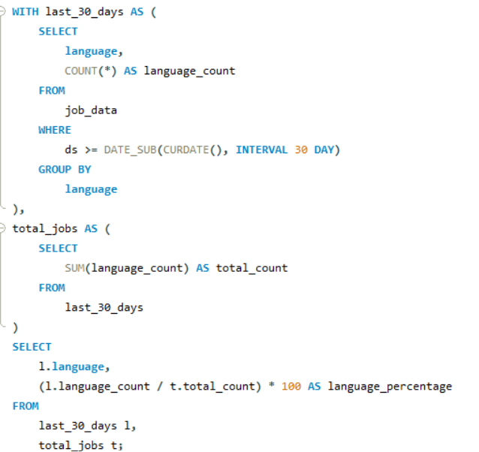
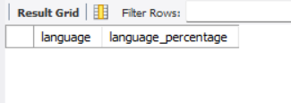

Slide 9
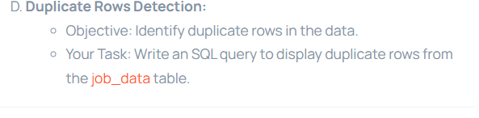
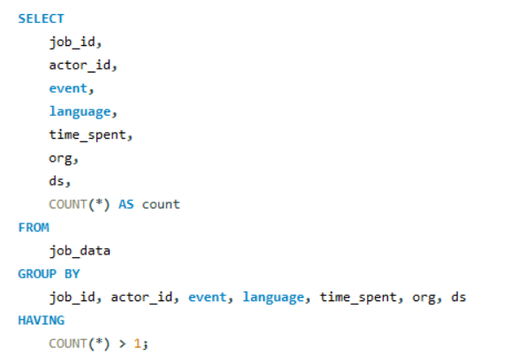
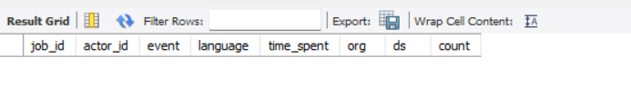

Slide 10
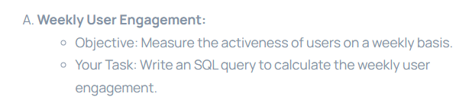
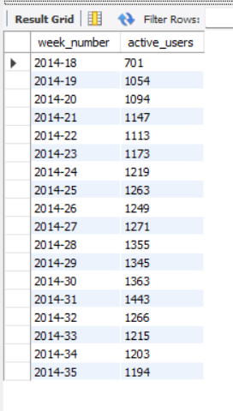
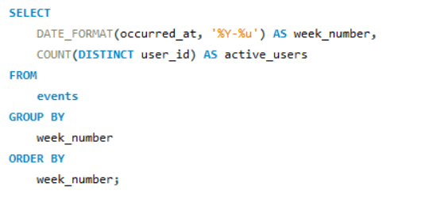

Slide 11
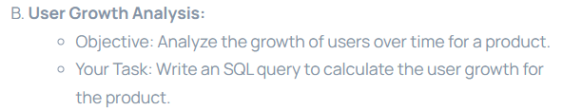
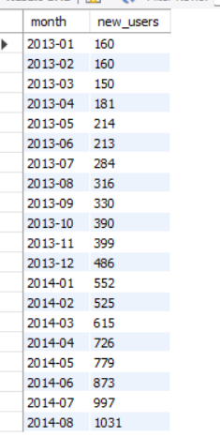
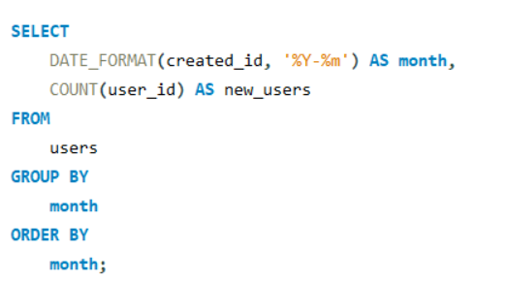

Slide 12
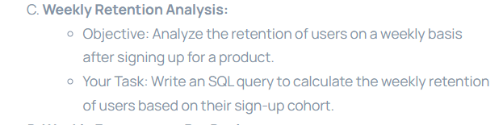
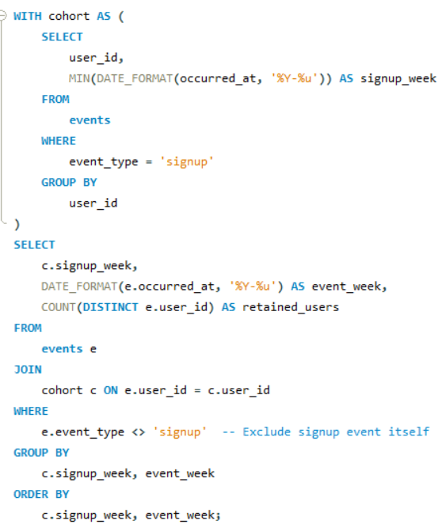


Slide 13
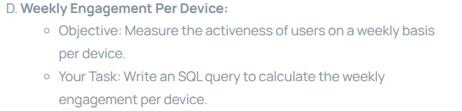
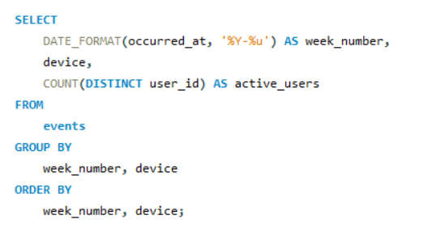
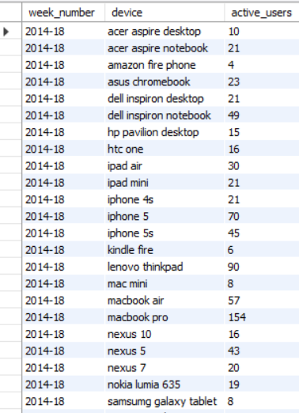

Slide 14
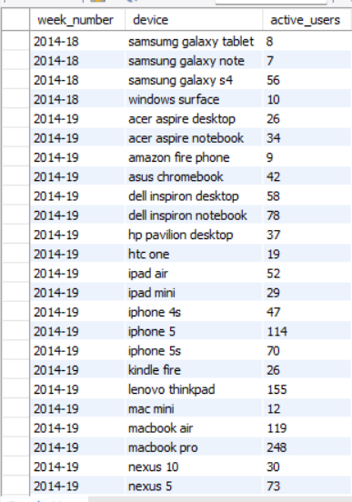
And more output present ….

Slide 15
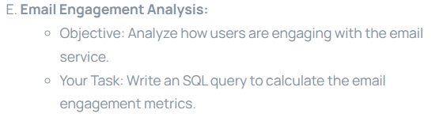
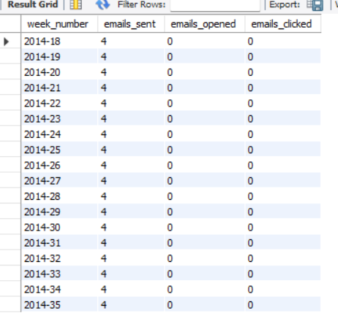
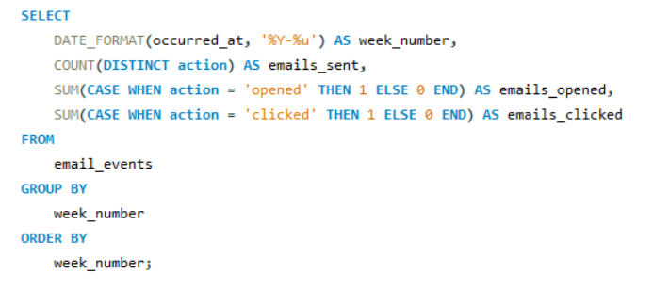

Slide 16
Thank You !

